Slide 1

MACHINE INTELLIGENCE
Dr. N MEHALA
Department of Computer Science and Engineering

Slide 2

MACHINE INTELLIGENCE
Module 4 [Unsupervised Learning]
Dr. N MEHALA
Department of Computer Science and Engineering

Slide 3
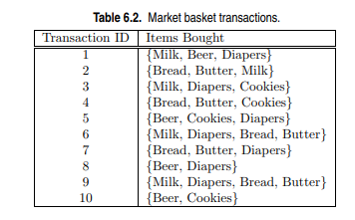
Practice Question 1
(d) Find an itemset (of size 2 or larger) that has the largest support.
(e) Find a pair of items, a and b, such that the rules {a} −→ {b} and {b} −→ {a} have the same confidence
(a) What is the maximum number of association rules that can be extracted from this data (including rules that have zero support)?
(b) What is the maximum size of frequent itemsets that can be extracted (assuming minsup > 0)?
(c) Write an expression for the maximum number of size-3 itemsets that can be derived from this data set.

Slide 4
Practice Question 2
Consider the following set of frequent 3-itemsets: {1, 2, 3}, {1, 2, 4}, {1, 2, 5}, {1, 3, 4}, {1, 3, 5}, {2, 3, 4}, {2, 3, 5}, {3, 4, 5}. Assume that there are only five items in the data set.
(a) List all candidate 4-itemsets obtained by a candidate generation procedure using the Fk−1 × F1 merging strategy.
(b) List all candidate 4-itemsets obtained by the candidate generation procedure in Apriori.
(c) List all candidate 4-itemsets that survive the candidate pruning step of the Apriori algorithm.

Slide 5
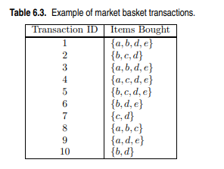
Practice Question 3
Draw an itemset lattice representing the data set given in Table 6.3. Label each node in the lattice with the following letter(s):
• N: If the itemset is not considered to be a candidate itemset by the Apriori algorithm. There are two reasons for an itemset not to be considered as a candidate itemset: (1) it is not generated at all during the candidate generation step, or (2) it is generated during the candidate generation step but is subsequently removed during the candidate pruning step because one of its subsets is found to be infrequent.
• F: If the candidate itemset is found to be frequent by the Apriori algorithm.
• I: If the candidate itemset is found to be infrequent after support counting.
(b) What is the percentage of frequent itemsets (with respect to all itemsets in the lattice)?
(c) What is the pruning ratio of the Apriori algorithm on this data set? (Pruning ratio is defined as the percentage of itemsets not considered to be a candidate because (1) they are not generated during candidate generation or (2) they are pruned during the candidate pruning step.)

Slide 6
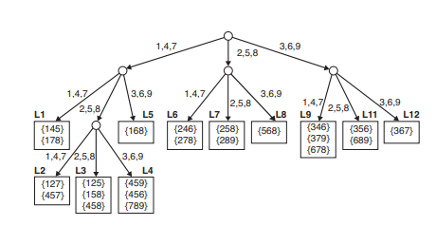
Practice Question 4
The Apriori algorithm uses a hash tree data structure to efficiently count the support of candidate itemsets. Consider the hash tree for candidate 3- itemsets shown in figure below:
Given a transaction that contains items {1, 3, 4, 5, 8}, which of the hash tree leaf nodes will be visited when finding the candidates of the transaction?
(b) Use the visited leaf nodes in part (b) to determine the candidate itemsets that are contained in the transaction {1, 3, 4, 5, 8}.

Slide 7
Practice Question 5
Consider the following set of candidate 3-itemsets: {1, 2, 3}, {1, 2, 6}, {1, 3, 4}, {2, 3, 4}, {2, 4, 5}, {3, 4, 6}, {4, 5, 6}
Construct a hash tree for the above candidate 3-itemsets. Assume the tree uses a hash function where all odd-numbered items are hashed to the left child of a node, while the even-numbered items are hashed to the right child. A candidate k-itemset is inserted into the tree by hashing on each successive item in the candidate and then following the appropriate branch of the tree according to the hash value. Once a leaf node is reached, the candidate is inserted based on one of the following conditions:
Condition 1: If the depth of the leaf node is equal to k (the root is assumed to be at depth 0), then the candidate is inserted regardless of the number of itemsets already stored at the node.
Condition 2: If the depth of the leaf node is less than k, then the candidate can be inserted as long as the number of itemsets stored at the node is less than maxsize. Assume maxsize = 2 for this question.
Condition 3: If the depth of the leaf node is less than k and the number of itemsets stored at the node is equal to maxsize, then the leaf node is converted into an internal node. New leaf nodes are created as children of the old leaf node. Candidate itemsets previously stored in the old leaf node are distributed to the children based on their hash values. The new candidate is also hashed to its appropriate leaf node.

Slide 8
THANK YOU
Dr. N MEHALA
Department of Computer Science and Engineering
mehala@pes.edu

